Slide 1

AIR POLLUTION IN DELHI
PRESENTED BY :-
Tirthesh Jain
STUDENT OF :-
B.TECH (CSE) 4th
Semester
PRESENTED TO :-
Ms. Navneet Kaur

Slide 2
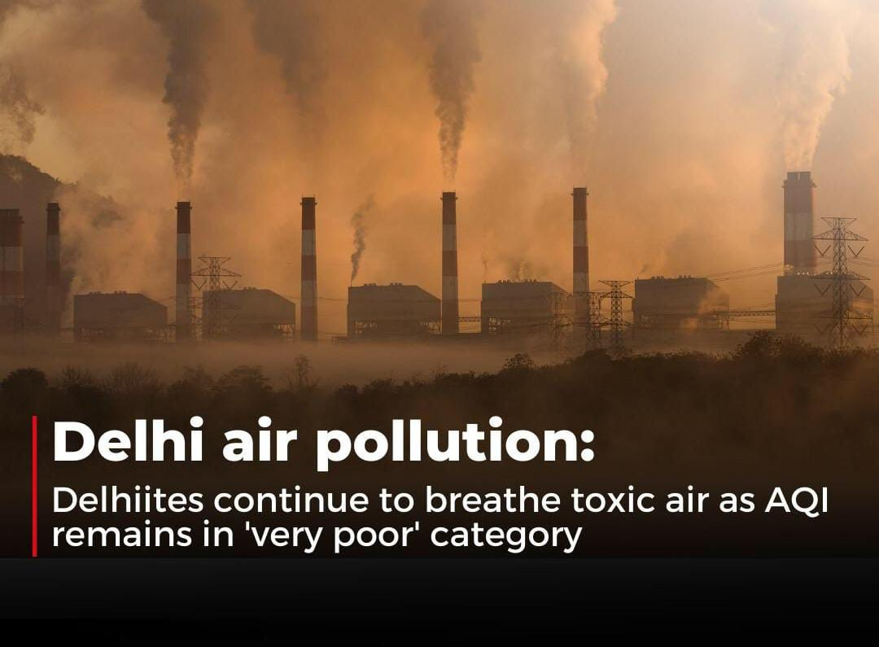
AIR POLLUTION IN DELHI

Slide 3
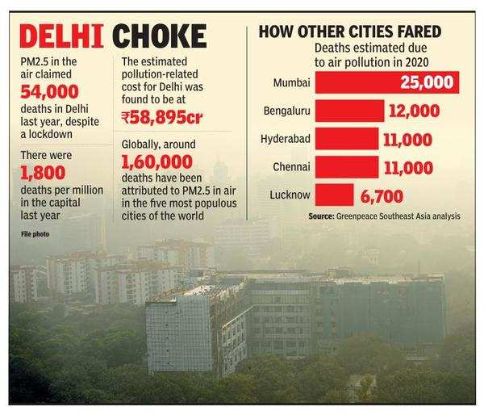
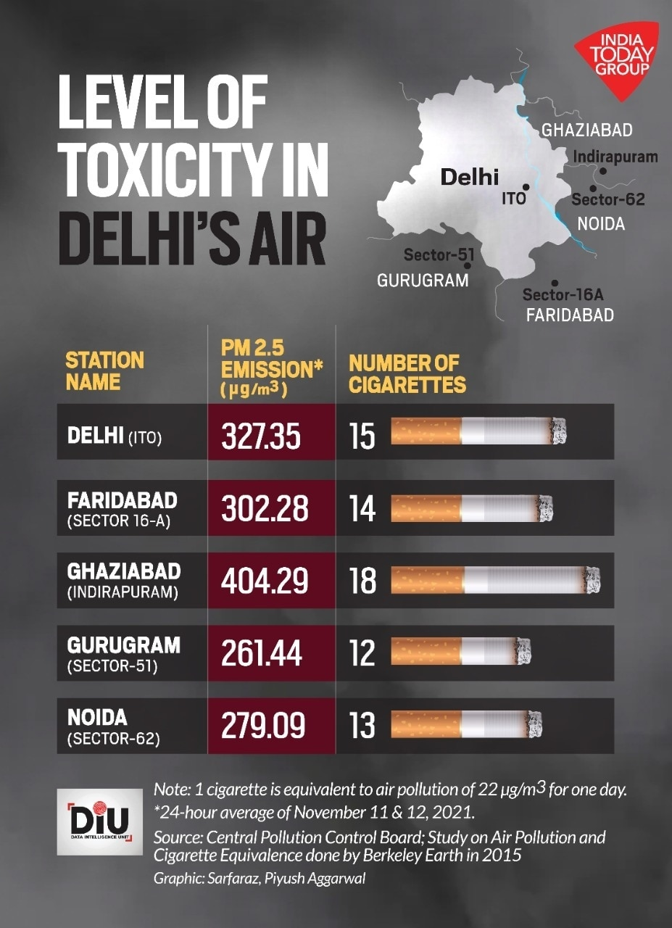
STATS OF DELHI POLLUTION

Slide 4
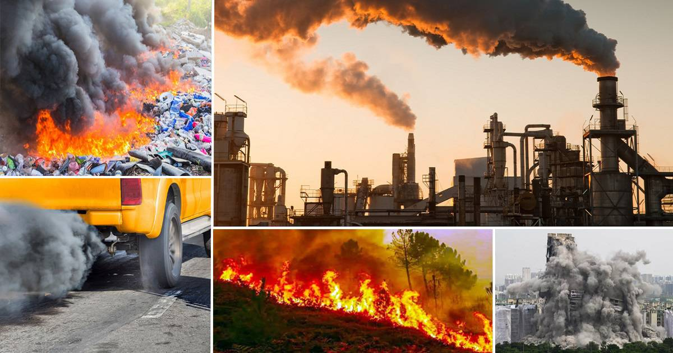
CAUSES OF POLLUTION IN DELHI

Slide 5
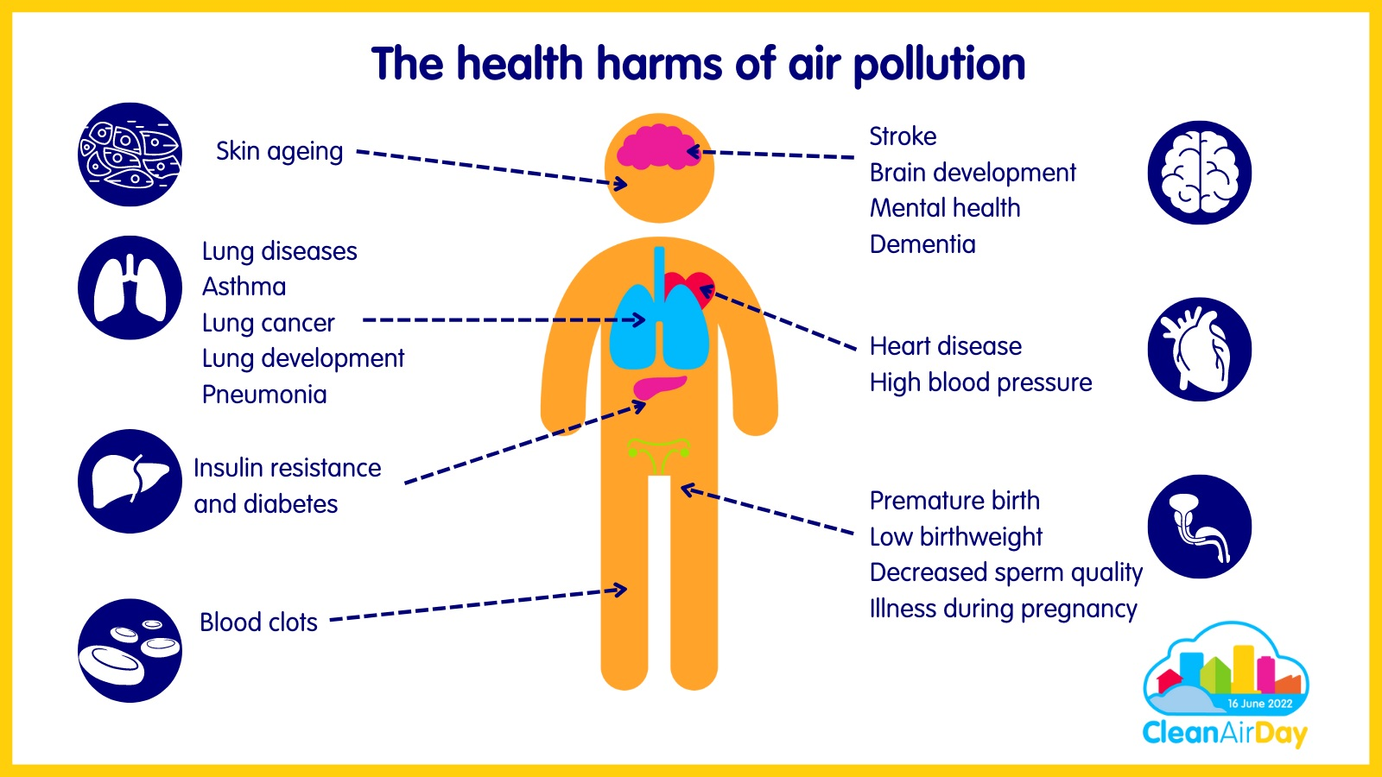
EFFECTS OF POLLUTION IN DELHI

Slide 6
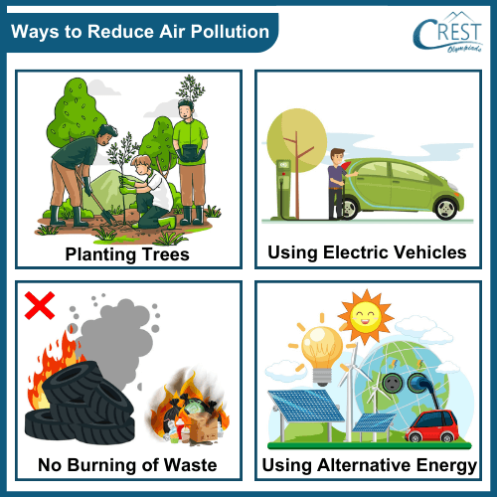
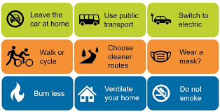
STEPS TO REDUCE POLLUTION IN DELHI

Slide 7
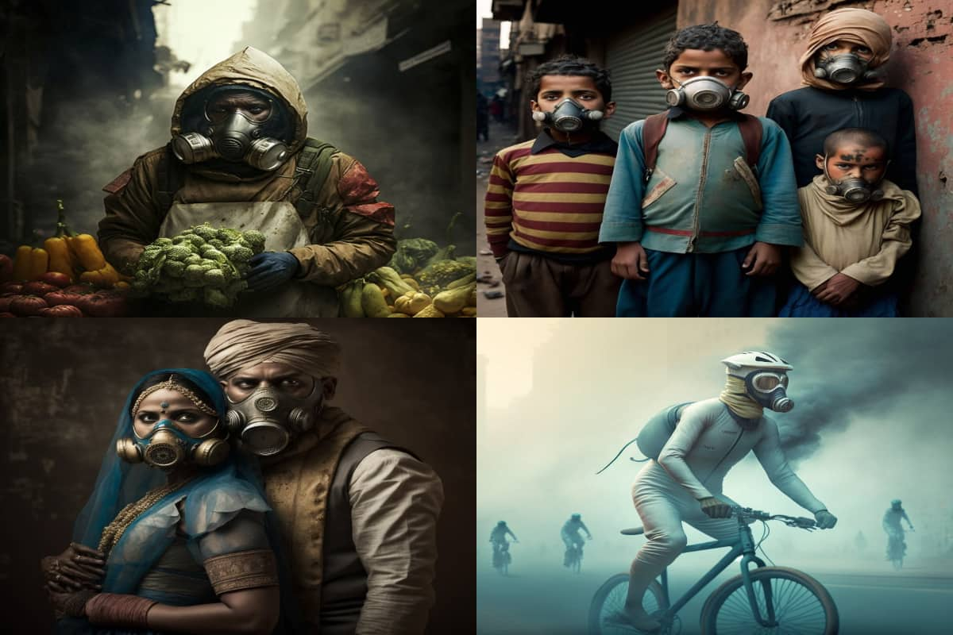
FUTURE OF AIR POLLUTION IN DELHI

Slide 8


Slide 9
BIBLIOGRAPHY
https://www.theguardian.com/world/2023/nov/03/delhi-india-air-quality-pollution- spike-world-health-organization-limit
https://www.bbc.com/news/world-asia-india-59808770
https://timesofindia.indiatimes.com/topic/delhi-air-pollution

Slide 10


